Slide 1
SUPPORT VECTOR MACHINE (SVM)

Slide 2
1. What is Support Vector Machine
Support Vector Machine is a supervised machine learning algorithm used for classification and regression, which finds an optimal decision boundary (hyperplane) that maximizes the margin between different classes.
For regression, it is called Support Vector Regression (SVR).
For regression, it is called Support Vector Classifier (SVC).

Slide 3
2. Purpose
To achieve maximum generalization by finding the decision boundary with the largest margin, making the model robust to noise and overfitting.

Slide 4
3. Why it is Used
Works well with high-dimensional data
Effective when number of features > number of samples
Strong theoretical guarantees
Can model non-linear relationships using kernels
Robust to overfitting with proper regularization

Slide 5
4. How SVM Works (Algorithm)
Core Ideas:
Maximum Margin Classifier
Support Vectors
Kernel Trick
Step-by-Step Algorithm:
Map input data into feature space
Find the hyperplane that maximizes margin
Identify support vectors (closest points)
Allow soft margin using slack variables
Optimize using quadratic programming

Slide 6
5. Mathematical Formulation
Hyperplane Equation:
w⋅x+b=0
Margin:
Margin=2/∥w∥ ​
Optimization Objective:
min⁡1/2∥w∥^2+C∑ξi
Subject to:
yi(w⋅xi+b)≥1−ξi

Slide 7
6. Kernel Trick (Non-Linearity)
Kernel | Formula | Use Case
Linear | (x_i \cdot x_j) | Linearly separable
Polynomial | ((\gamma x_i \cdot x_j + r)^d) | Curved boundaries
RBF (Gaussian) | (e^{-\gamma |x_i - x_j|^2}) | Complex non-linear
Sigmoid | (\tanh(\gamma x_i \cdot x_j + r)) | Neural-like

Slide 8
7. Technical Details
Types of SVM:
Support Vector Classifier (SVC)
Support Vector Regression (SVR)
Loss Function:
Hinge Loss
L=max⁡(0,1−y(w⋅x))
Optimization:
Quadratic Programming
Sequential Minimal Optimization (SMO)

Slide 9
8. Parameters
Model Parameters (Learned):
Weight vector www
Bias bbb
Support vectors
Dual coefficients
Hyperparameters:
Parameter | Meaning
C | Regularization strength
kernel | Kernel type
gamma | Influence of single point
degree | Polynomial degree
epsilon | Margin width (SVR)

Slide 10
9. Assumptions
Data is separable (or approximately separable)
Correct kernel choice captures structure
Features are scaled

Slide 11
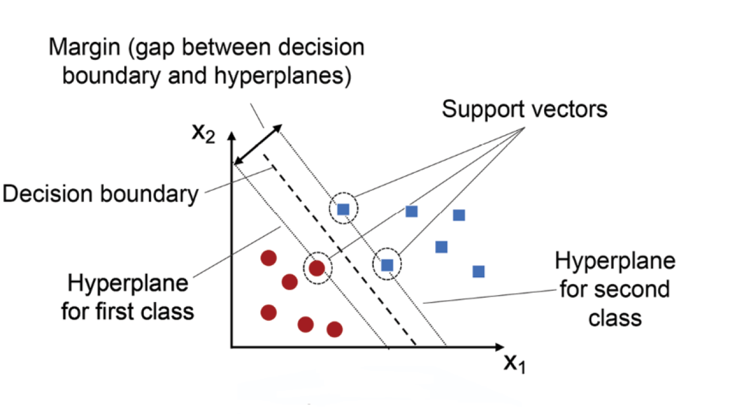

Slide 12
10. Pros
Strong generalization
Works in high-dimensional spaces
Effective with small datasets
Flexible using kernels
Robust to overfitting

Slide 13
11. Cons
Computationally expensive
Memory intensive
Hard to interpret
Sensitive to hyperparameters
Not scalable to very large datasets

Slide 14
12. Real-World Applications
Text & NLP:
Spam detection
Sentiment analysis
Document classification
Image Processing:
Face recognition
Handwritten digit recognition
Bioinformatics:
Cancer classification
Gene expression analysis
Finance:
Credit risk prediction
Fraud detection

Slide 15
12. SVM vs Other Models
Model | Key Difference
Logistic Regression | SVM maximizes margin
Decision Tree | SVM uses geometry
Random Forest | SVM is deterministic
Neural Networks | SVM has convex optimization

Slide 16
14. Support Vector Regression (SVR)
Idea:
Fits a function within an ε-tube, ignoring small errors.
Objective:
min⁡1/2∥w∥^2+C∑(ξi+ξi∗)

Slide 17
Summary
Support Vector Machine is a margin-based, kernel-powered algorithm that delivers strong performance on high-dimensional and non-linear problems.

